Slide 1
ICTW-b
Name : Suthar Adarsh Sujalkumar
Roll No : CE124
ID No : 20CEUBS017
Experiment : 2
Lab : 2

Slide 2
PROBLEM 3 : Create a Home page named index.php
<!DOCTYPE html>
<html>
<body bgcolor="white">
<form action="index.php" method="POST">
<table border='1'>
<tr>
<td>Username: </td>
<td><input typr="text" name="username" /></td>
</tr>
<tr>
<td>password: </td>
<td><input typr="password" name="password" /></td>
</tr>

Slide 3
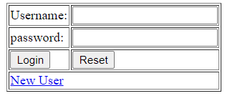
<tr>
<td><button type="Login">Login</button></td>
<td><button type="Reset">Reset</button></td>
</tr>
<tr>
<td colspan="2"><a href="registration.php">New User</a></td>
</tr>
</body>
</table>
</form>
</html>
Output:

Slide 4
PROBLEM 4. Create a registration form for a new user named registration.php
<!DOCTYPE html>
<html>
<body bgcolor="white">
<form action="index.php" method="POST">
<table border='1'>
<tr>
<td colspan="3">*Required Field </td>
</tr>
<tr>
<td>*User Name : </td>
<td colspan="2"><input type="text" name="User"></td>
</tr>
<tr>
<td>*Email address : </td>
<td colspan="2"><input type="text" name="Email"></td>
</tr>

Slide 5
<tr>
<td>*Password : </td>
<td colspan="2"><input type="Password" name="Password"></td>
</tr>
<tr>
<td>*Confirm password : </td>
<td colspan="2"><input type="password" name="password"></td>
</tr>
<tr>
<td>*Gender : </td>
<td colspan="2"><input type="radio" name="Gender" >female
<input type="radio" name="Gender" >male</td>
</tr>
<tr>
<td colspan="3">Achievement :</td></td>
</tr>
<tr>
<td colspan="3"><textarea name="Achievement" rows='10' cols='50'></textarea></td>
</tr>

Slide 6
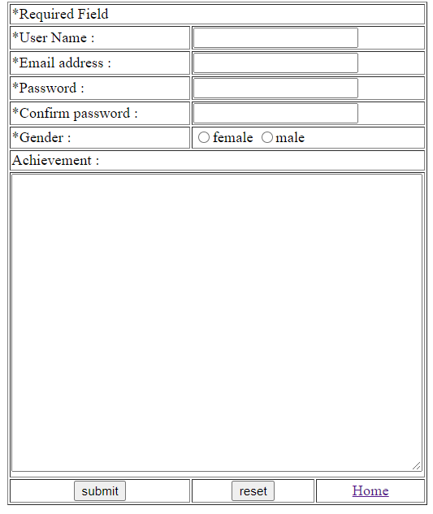
<tr>
<td><center><button type="submit">submit</button></center><a href="notification.php"></a></td>
<td> <center><button type="reset">reset</button></center> <a href="registration.php"></a></td>
<td><center><a href="index.php">Home</a></center></td>
</tr>
</table>
</form>
</body>
</html>
Output:

Slide 7
<?php
if( isset($_POST["User"]) & isset($_POST["Email"]) & isset($_POST["Password"]) &
isset($_POST["Password"]) & isset($_POST["Gender"]) &
isset($_POST["Achievement"]) )
{
if( !empty($_POST["User"]) & !empty($_POST["Email"]) &
!empty($_POST["Password"]) & !empty($_POST["Password"]) &
!empty($_POST["Gender"]) & !empty($_POST["Achievement"]) )
{
if((strlen($_POST["User"]) < 11) && (strlen($_POST["password"]) > 10
|| strlen($_POST["password"]) < 6) )
{
echo "Invalid Username and Password"."</br>";
}
else if(strlen($_POST["User"]) < 11)
{
echo "Invalid Username"."</br>";
}
else if(strlen($_POST["password"]) > 10 ||
strlen($_POST["password"]) < 6 )
{
echo "Invalid Password"."</br>";

Slide 8
}
else
{
echo "YOU ARE REGISTERED"."</br>";
echo "<br/>";
echo "<br/>";
echo "NAME : ". $_POST['User']."</br>";
echo "E-mail : ". $_POST['Email']."</br>";
echo "password : ". $_POST['Password']."</br>";
echo "Gender : ". $_POST['Gender']."</br>";
echo "Achievement : ". $_POST['Achievement']."</br>";
}
}else
echo "some fields are empty";
}
else
echo "some fields are empty";
?>

Slide 9
<!DOCTYPE html>
<html>
<body bgcolor="white">
<form action="index.php" method="POST">
<button type="Login">Login</button><a href="index.php"></a>
</form>
</body>
</html>

